Slide 1
The assembler for x-86
The Netwide Assembler - NASM

Slide 2
What is nasm?
The Netwide Assembler (NASM) is an assembler and disassembler for the Intel x86 architecture. It can be used to write 16-bit, 32-bit (IA-32) and 64-bit (x86-64) programs. NASM is considered to be one of the most popular assemblers for Linux.

Slide 3
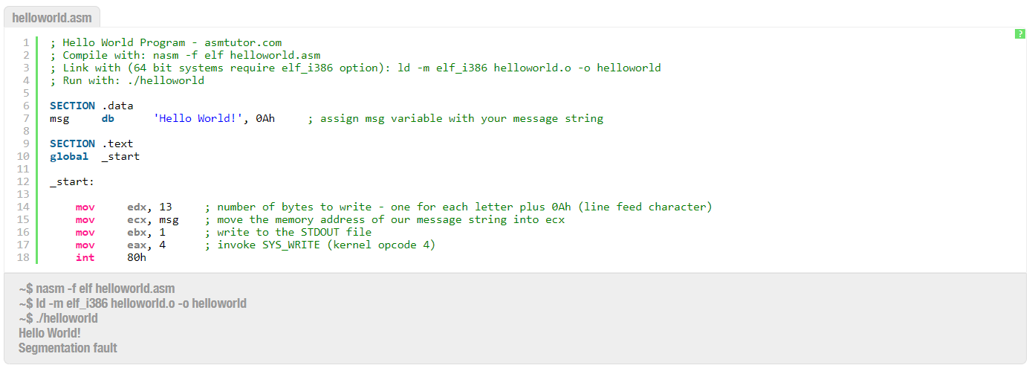
This is how you write “hello world” with NASM

Slide 4
The basic syntax
data (initialize data or constants)
bss (declare variables)
text (keep the actual code)

Slide 5
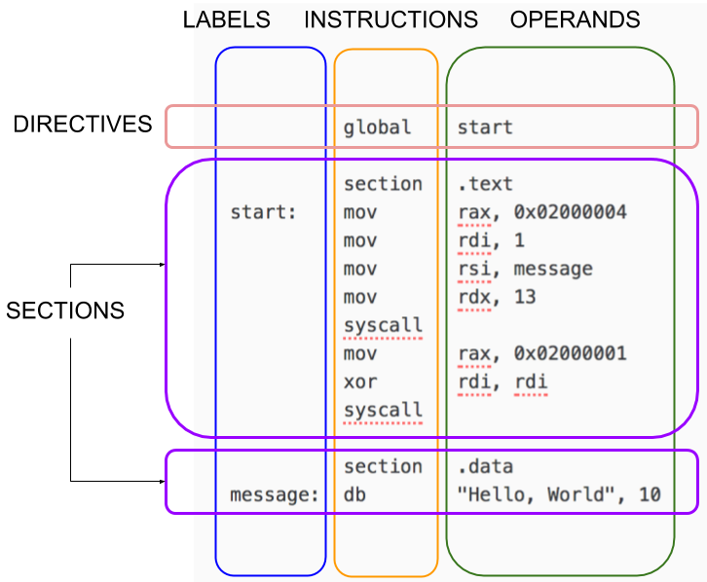

Slide 6
Comment: use semi colon (;) at the beginning of your comment message
Assembly Language Statements:
Assembly language programs consist of three types of statements
Executable instructions or instructions : tell the processor what to do
Assembler directives or pseudo-ops : tell the assembler about the various aspects of the assembly process. These are non-executable and do not generate machine language instructions.
Macros : basically a text substitution mechanism
Syntax of Assembly Language Statements

Slide 7
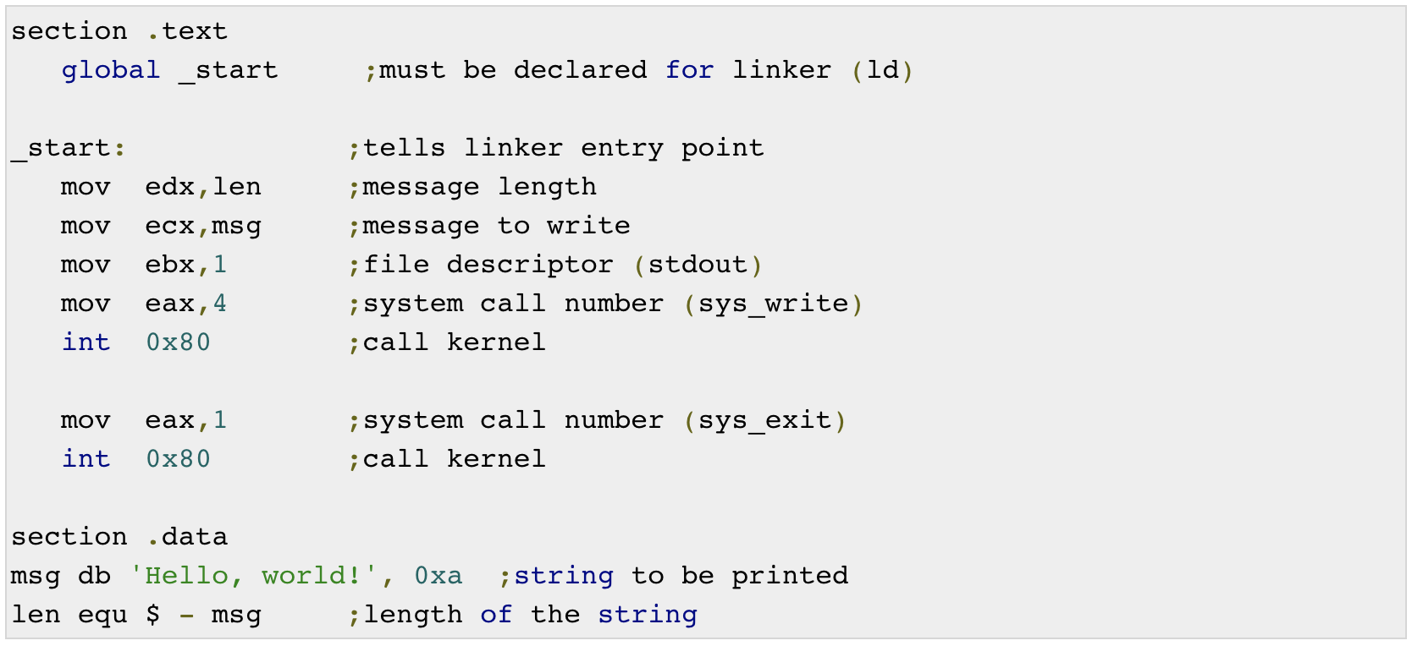
Playground: https://www.tutorialspoint.com/compile_asm_online.php

Slide 8
Registers
There are ten 32-bit and six 16-bit processor registers in IA-32 architecture. The registers are grouped into three categories:
General registers,
Control registers, and
Segment registers.
The general registers are further divided into the following groups:
Data registers,
Pointer registers, and
Index registers.

Slide 9
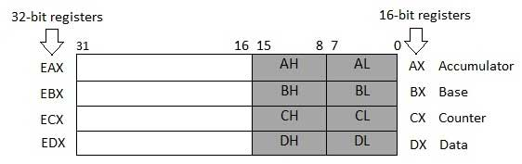
Data Registers

Slide 10
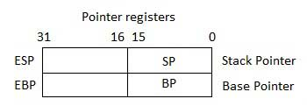
Pointer Registers
The pointer registers are 32-bit EIP, ESP, and EBP registers and corresponding 16-bit right portions IP, SP, and BP.
There are three categories of pointer registers
Instruction Pointer (IP) − The 16-bit IP register stores the offset address of the next instruction to be executed. IP in association with the CS register (as CS:IP) gives the complete address of the current instruction in the code segment.
Stack Pointer (SP) − The 16-bit SP register provides the offset value within the program stack. SP in association with the SS register (SS:SP) refers to be current position of data or address within the program stack.
Base Pointer (BP) − The 16-bit BP register mainly helps in referencing the parameter variables passed to a subroutine. The address in SS register is combined with the offset in BP to get the location of the parameter. BP can also be combined with DI and SI as base register for special addressing.

Slide 11
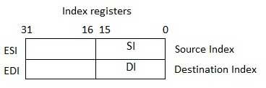
Index Registers
The 32-bit index registers, ESI and EDI, and their 16-bit rightmost portions. SI and DI, are used for indexed addressing and sometimes used in addition and subtraction.
There are two sets of index pointers:
Source Index (SI) − It is used as source index for string operations.
Destination Index (DI) − It is used as destination index for string operations.

Slide 12
Control Registers
The common flag bits are:
Overflow Flag (OF) − It indicates the overflow of a high-order bit (leftmost bit) of data after a signed arithmetic operation.
Direction Flag (DF) − It determines left or right direction for moving or comparing string data. When the DF value is 0, the string operation takes left-to-right direction and when the value is set to 1, the string operation takes right-to-left direction.
Interrupt Flag (IF) − It determines whether the external interrupts like keyboard entry, etc., are to be ignored or processed. It disables the external interrupt when the value is 0 and enables interrupts when set to 1.
Trap Flag (TF) − It allows setting the operation of the processor in single-step mode. The DEBUG program we used sets the trap flag, so we could step through the execution one instruction at a time.

Slide 13
Sign Flag (SF) − It shows the sign of the result of an arithmetic operation. This flag is set according to the sign of a data item following the arithmetic operation. The sign is indicated by the high-order of leftmost bit. A positive result clears the value of SF to 0 and negative result sets it to 1.
Zero Flag (ZF) − It indicates the result of an arithmetic or comparison operation. A nonzero result clears the zero flag to 0, and a zero result sets it to 1.
Auxiliary Carry Flag (AF) − It contains the carry from bit 3 to bit 4 following an arithmetic operation; used for specialized arithmetic. The AF is set when a 1-byte arithmetic operation causes a carry from bit 3 into bit 4.
Parity Flag (PF) − It indicates the total number of 1-bits in the result obtained from an arithmetic operation. An even number of 1-bits clears the parity flag to 0 and an odd number of 1-bits sets the parity flag to 1.
Carry Flag (CF) − It contains the carry of 0 or 1 from a high-order bit (leftmost) after an arithmetic operation. It also stores the contents of last bit of a shift or rotate operation.

Slide 14
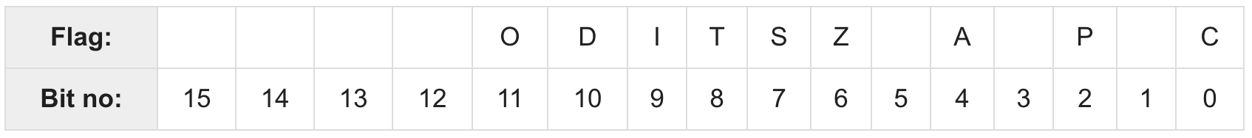
position of flag bits in the 16-bit Flags register

Slide 15
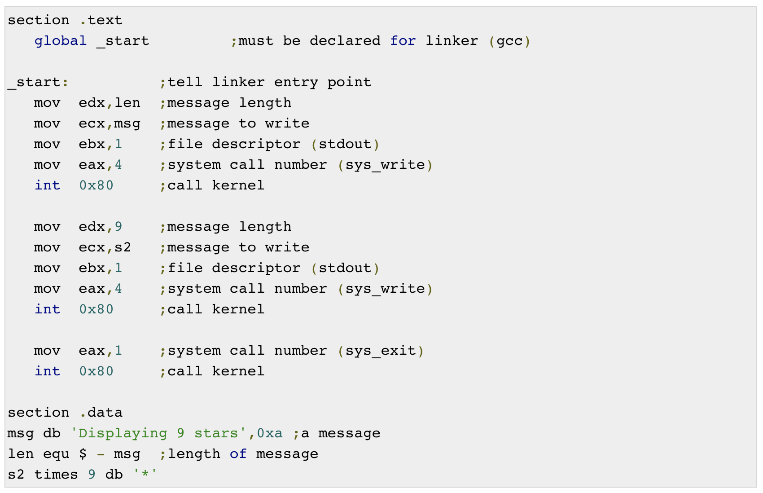

Slide 16
System Call
What is System Call?
System calls are APIs for the interface between the user space and the kernel space.
Then, what is Kernel?
The kernel is a computer program at the core of a computer's operating system that has complete control over everything in the system

Slide 17
How do you use system call in the assembly?
To use I/O resources
To stop/start program
To intterrupt the application flow when something happen
%eax | Name | %ebx | %ecx | %edx | %esx | %edi
1 | sys_exit | int | - | - | - | -
2 | sys_fork | struct pt_regs | - | - | - | -
3 | sys_read | unsigned int | char * | size_t | - | -
4 | sys_write | unsigned int | const char * | size_t | - | -
5 | sys_open | const char * | int | int | - | -
6 | sys_close | unsigned int | - | - | - | -

Slide 18

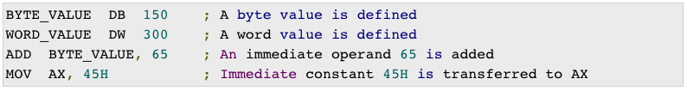
Addressing mode
NASM use 3 basic addressing modes:
Register addressing
Immediate addressing
Memory addressing
Register addressing
Immediate addressing

Slide 19
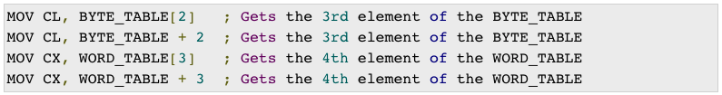
Addressing mode
Direct Memory addressing
Direct-Offset Addressing

Slide 20
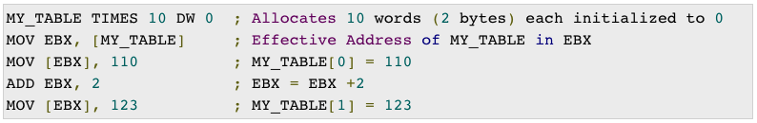
Addressing mode
Indirect Memory addressing
MOV Instruction is the one that works closely with addressing modes

Slide 21
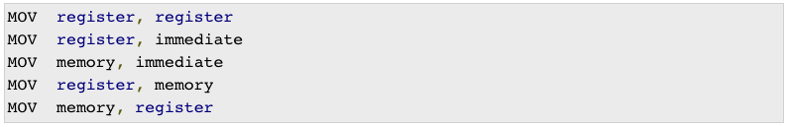
Mov Instruction with addressing modes
Syntax:
Typical form of instruction MOV
Both operands in MOV should be of same size
The value of source operand remains unchanged

Slide 22
Mov Instruction with addressing modes
You should always use a type specifiers when moving data:
Type Specifier | Bytes addressed
BYTE | 1
WORD | 2
DWORD | 4
QWORD | 8
TBYTE | 10

Slide 23
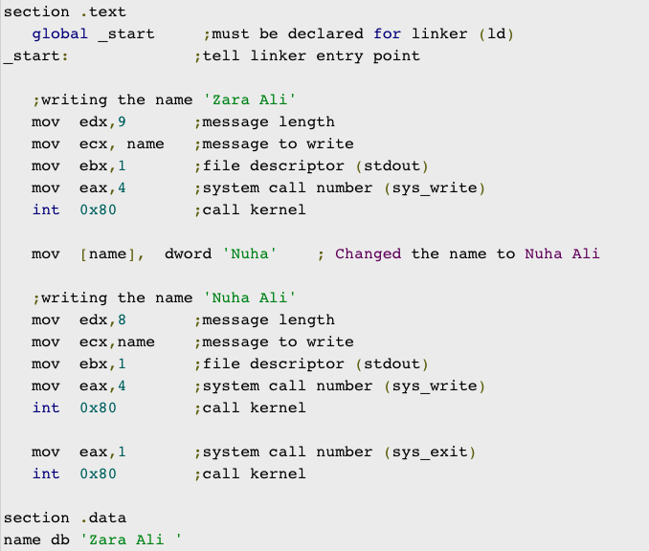

Slide 24
Variables & Constants
Like other programming languages, you can define variables and constants
Directive | Purpose | Storage Space
DB | Define Byte | allocates 1 byte
DW | Define Word | allocates 2 bytes
DD | Define Doubleword | allocates 4 bytes
DQ | Define Quadword | allocates 8 bytes
DT | Define Ten Bytes | allocates 10 bytes
Define-directive

Slide 25
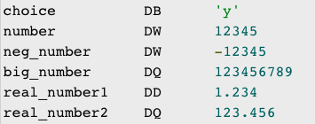
Variables & Constants
Example:
Notes:
Each byte of character is stored as its ASCII value in hexadecimal.
Each decimal value is automatically converted to its 16-bit binary equivalent and stored as a hexadecimal number.
Processor uses the little-endian byte ordering.
Negative numbers are converted to its 2's complement representation.
Short and long floating-point numbers are represented using 32 or 64 bits, respectively

Slide 26
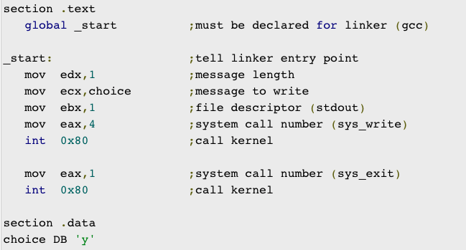

Slide 27
Variables & Constants
What if you want to declare a variable without initialize value?
Use these directive instead:
Directive | Purpose
RESB | Reserve a Byte
RESW | Reserve a Word
RESD | Reserve a Doubleword
RESQ | Reserve a Quadword
REST | Reserve a Ten Bytes

Slide 28




Variables & Constants
To create constants, there are 3 directives:
EQU : Define numeric value and cannot be re-declared
%assign : Define numeric value and allow redifinition
%define : Define both numeric and string value. It allows redifinition
Examples:

Slide 29
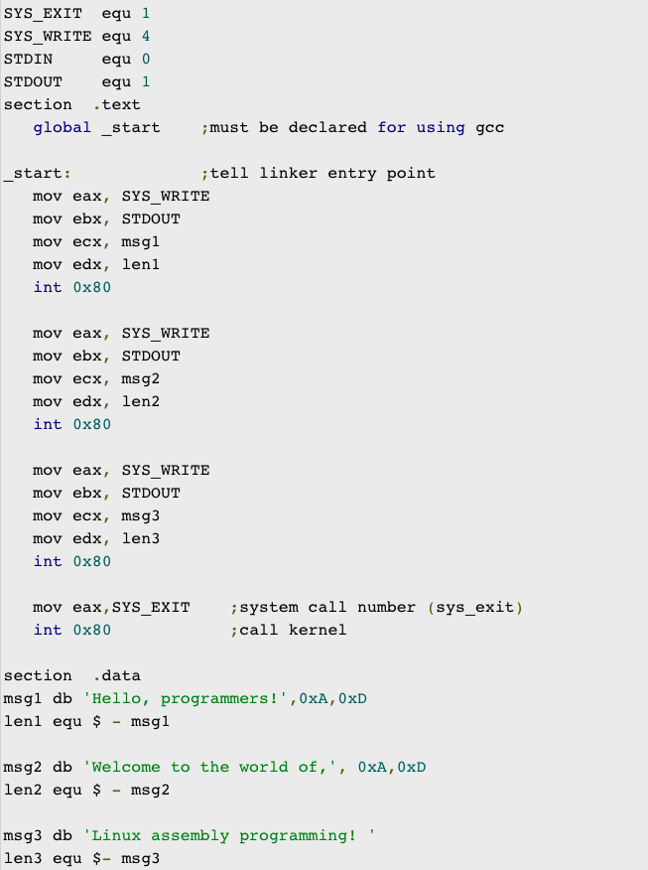

Slide 30
Arithmetic instruction
The available instructions:
Increase instruction : INC destination
Decrease instruction: DEC destination
Add/Sub instructions: ADD/SUB destination, source
MUL/IMUL instructions: MUL/IMUL multiplier
DIV/IDIV instuctions: DIV/IDIV divisor

Slide 31
Logical instructions
New value of operand1
AND operand1, operand2 (AND 0101, 0011 = 0001)
OR operand1, operand2 (OR 0101, 0011 = 0111)
XOR operand1, operand2 (XOR 0101, 0011 = 0110)
TEST operand1, operand2 (Just like AND without changing operand1)
NOT operand1 (NOT 01010011 = 10101100)
Use these instructions will also trigger the flags such as CF, OF, PF, SF, ZF flags so this will useful for operations: compare, match, clear …..

Slide 32
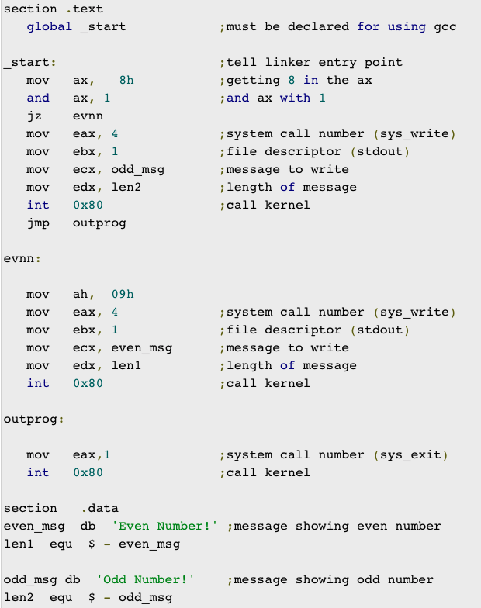
You can do AND instruction between a number with 01H. If ZF flag is trigger, that mean the number is EVEN.
In this example, you can see the jz and jmp branch instruction.

Slide 33
condition
Like what we have learnt from the previous simulator, NASM provides 2 types conditional instruction by using the branch instructions with the flags
Unconditional jump: JMP label
Conditional jump: Any instruction that affect the flags can be used in combination with the following condition instructions:

Slide 34
Instruction | Description | Flags tested
JE/JZ | Jump Equal or Jump Zero | ZF
JNE/JNZ | Jump not Equal or Jump Not Zero | ZF
JG/JNLE | Jump Greater or Jump Not Less/Equal | OF, SF, ZF
JGE/JNL | Jump Greater/Equal or Jump Not Less | OF, SF
JL/JNGE | Jump Less or Jump Not Greater/Equal | OF, SF
JLE/JNG | Jump Less/Equal or Jump Not Greater | OF, SF, ZF
Instruction | Description | Flags tested
JE/JZ | Jump Equal or Jump Zero | ZF
JNE/JNZ | Jump not Equal or Jump Not Zero | ZF
JA/JNBE | Jump Above or Jump Not Below/Equal | CF, ZF
JAE/JNB | Jump Above/Equal or Jump Not Below | CF
JB/JNAE | Jump Below or Jump Not Above/Equal | CF
JBE/JNA | Jump Below/Equal or Jump Not Above | AF, CF
Used for arithmetic operations
Used for logical operations

Slide 35
Instruction | Description | Flags tested
JXCZ | Jump if CX is Zero | none
JC | Jump If Carry | CF
JNC | Jump If No Carry | CF
JO | Jump If Overflow | OF
JNO | Jump If No Overflow | OF
JP/JPE | Jump Parity or Jump Parity Even | PF
JNP/JPO | Jump No Parity or Jump Parity Odd | PF
JS | Jump Sign (negative value) | SF
JNS | Jump No Sign (positive value) | SF

Slide 36
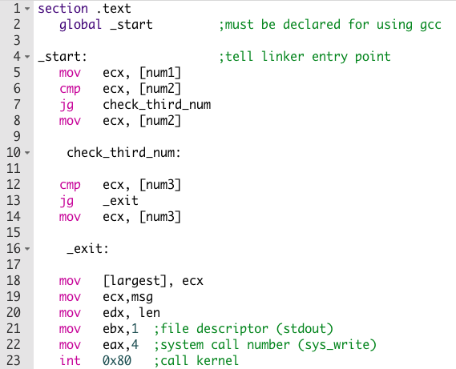
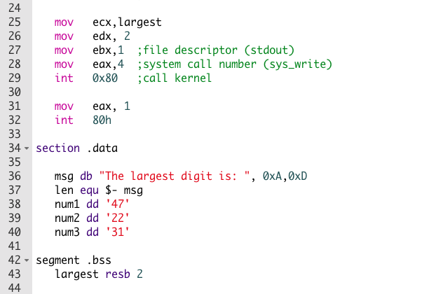
Example of finding the biggest number of 3 values

Slide 37
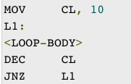

loop
With branch/condition instruction, you can write a loop.
But there is also other way to do so.
Instruction: loop label
Loop instruction work with ECX register as counter. It run until the counter (ecx) reach 0

Slide 38
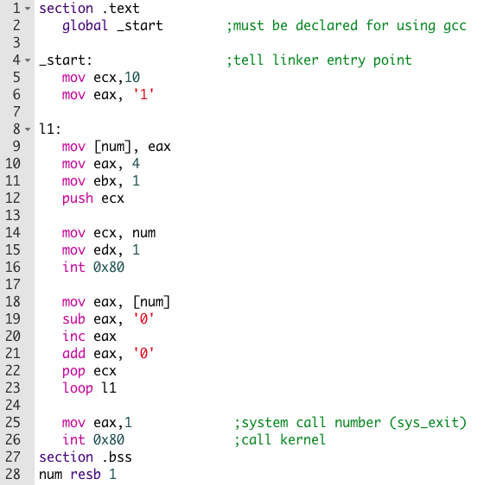
Example to print 123456789:

Slide 39
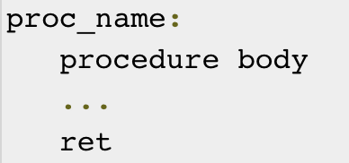

Procedure
Procedure or Subroutines is a block of code which can be called multiple times.
Procedures are identified by a name. Following this name, the body of the procedure is described which performs a well-defined job. End of the procedure is indicated by a return statement.

Slide 40
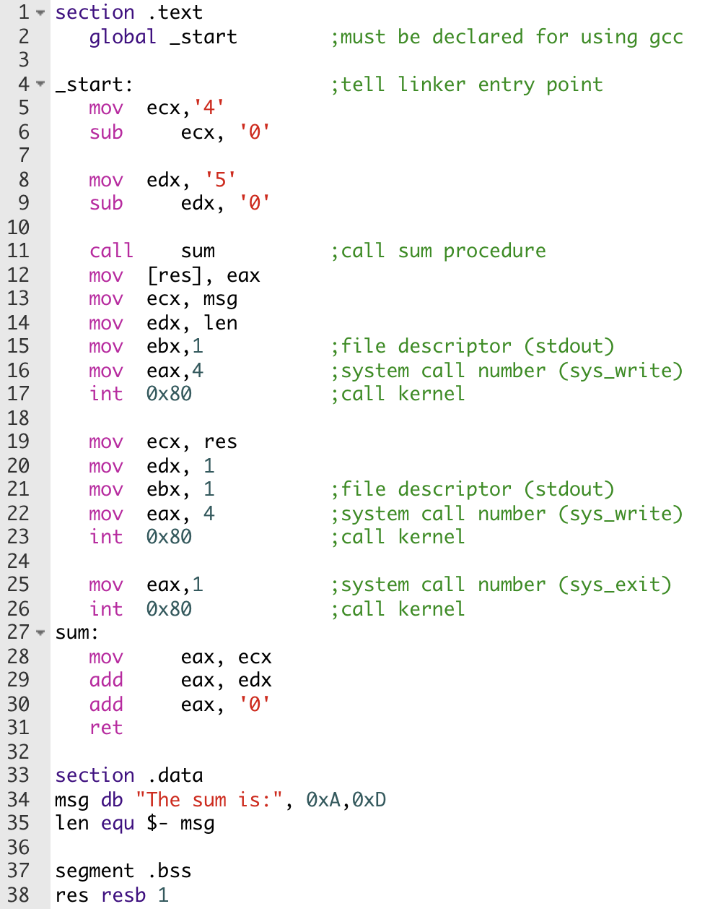

Slide 41
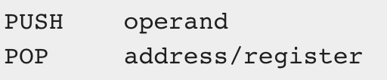
Stack data structure
A stack is an array-like data structure in the memory in which data can be stored and removed from a location called the 'top' of the stack. The data that needs to be stored is 'pushed' into the stack and data to be retrieved is 'popped' out from the stack. Stack is a LIFO data structure, i.e., the data stored first is retrieved last.
Notes:
Only words or doublewords could be saved into the stack, not a byte
The stack grows in the reverse direction, i.e., toward the lower memory address
The top of the stack points to the last item inserted in the stack; it points to the lower byte of the last word inserted

Slide 42
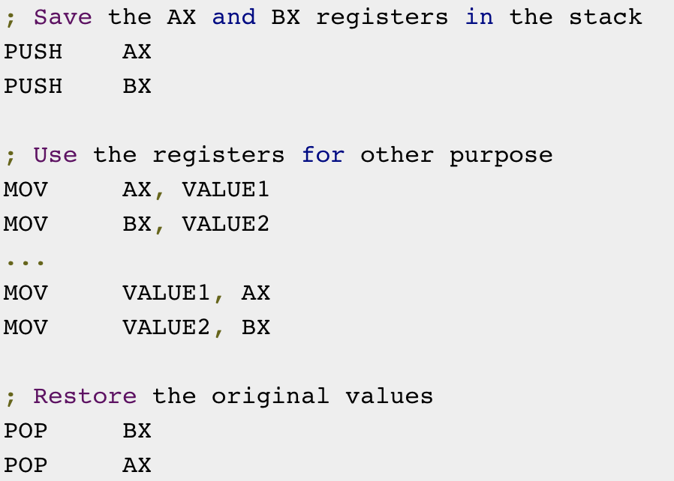

Slide 43
Example 2
Display the following format with procedure + stack:
Eax = 5
Output:
*
**
***
****
*****

